Slide 1
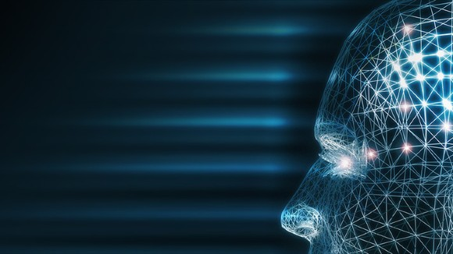
Introduction to Machine Learning
Lei Qian, Ph.D., Meharry Medical College
NSF NDSA Workshop, Oct 29-30, 2024

Slide 2
The Goals of This Workshop
What is Machine Learning - its relation to AI and Deep Learning
Classifications of Machine Learning
Principles and key components of Machine Learning - bias, variance, training, testing, and validation data etc.
Popular Machine Learning models: Neural Network, Support Vector Machine, Decision Tree, Random Forest, etc.
Sciket-Learn - a powerful and popular ML library.

Slide 3
What is Machine Learning
Machine learning is a subfield of Aritifical Intelligence (AI) that explores the study and construction of algorithms that can learn from and make decisions on data without having to program.
Instead of relying on predefined rules, ML algorithms use patterns in data to improve performance over time.
Examples of ML:
Speech Recognition
Object detection
Playing games
Medical diagnosis
Anomaly detection
GenAI (ChatGPT, Copilot, etc)

Slide 4
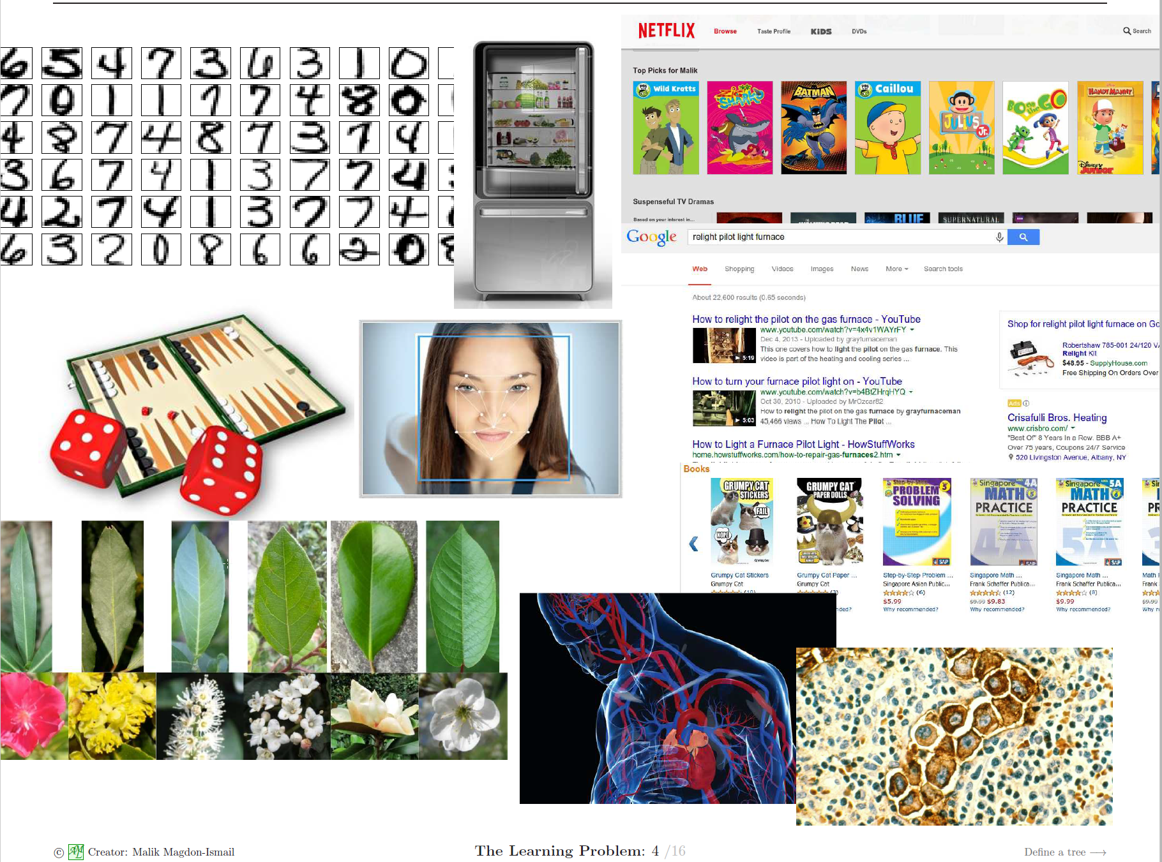

Slide 5
What is Artificial Intelligence
In computer science, artificial intelligence (AI), sometimes called machine intelligence, is intelligence demonstrated by machines. It is a broader concept comparing to Machine Learning.
The term "artificial intelligence" is often used to describe machines (or computers) that mimic "cognitive" functions that humans associate with the human mind, such as "learning" and "problem solving"
Challenges of AI includes reasoning, problem solving, knowledge presentation, etc.
Methods of AI includes symbolic reasoning, statistical learning etc.

Slide 6
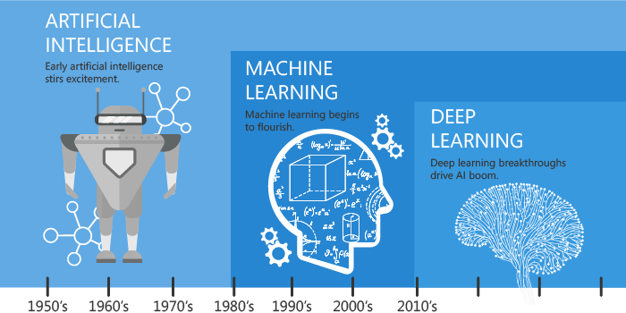
What is Artificial Intelligence
https://hackernoon.com/difference-between-artificial-intelligence-machine-learning-and-deep-learning-1pcv3zeg

Slide 7
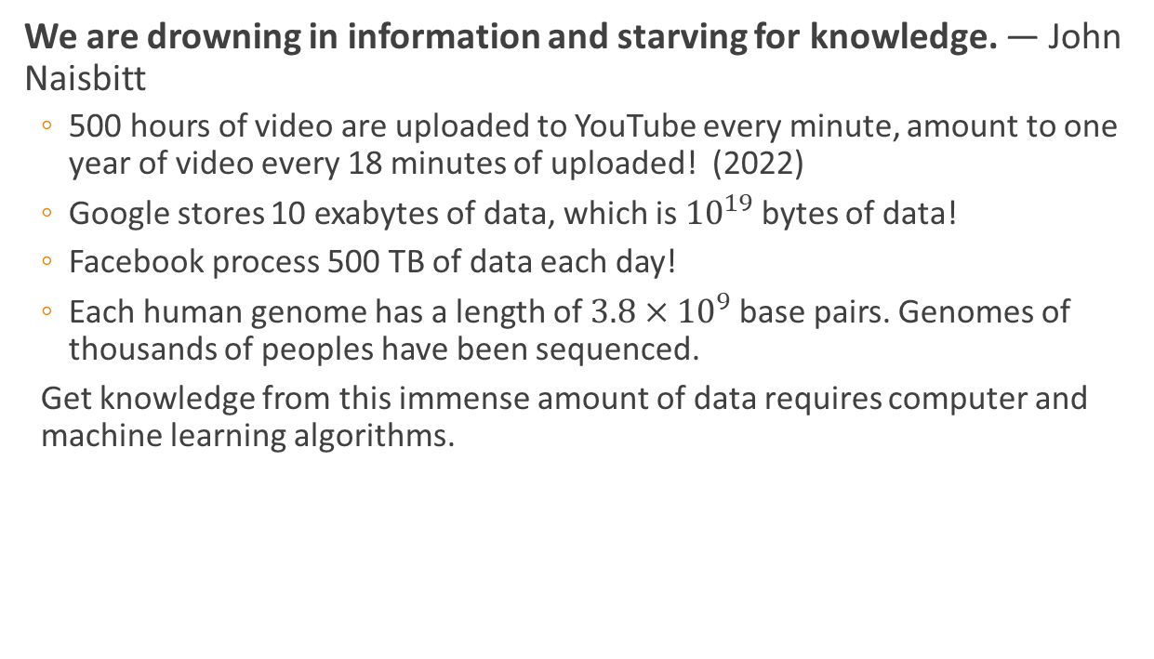
Why machine learning:
We are drowning in information and starving for knowledge. — John Naisbitt
500 hours of video are uploaded to YouTube every minute, amount to one year of video every 18 minutes of uploaded! (2022)
Google stores 10 exabytes of data, which is ${10}^{19}$ bytes of data!
Facebook process 500 TB of data each day!
Each human genome has a length of $3.8×{10}^{9}$ base pairs. Genomes of thousands of peoples have been sequenced.
Get knowledge from this immense amount of data requires computer and machine learning algorithms.

Slide 8
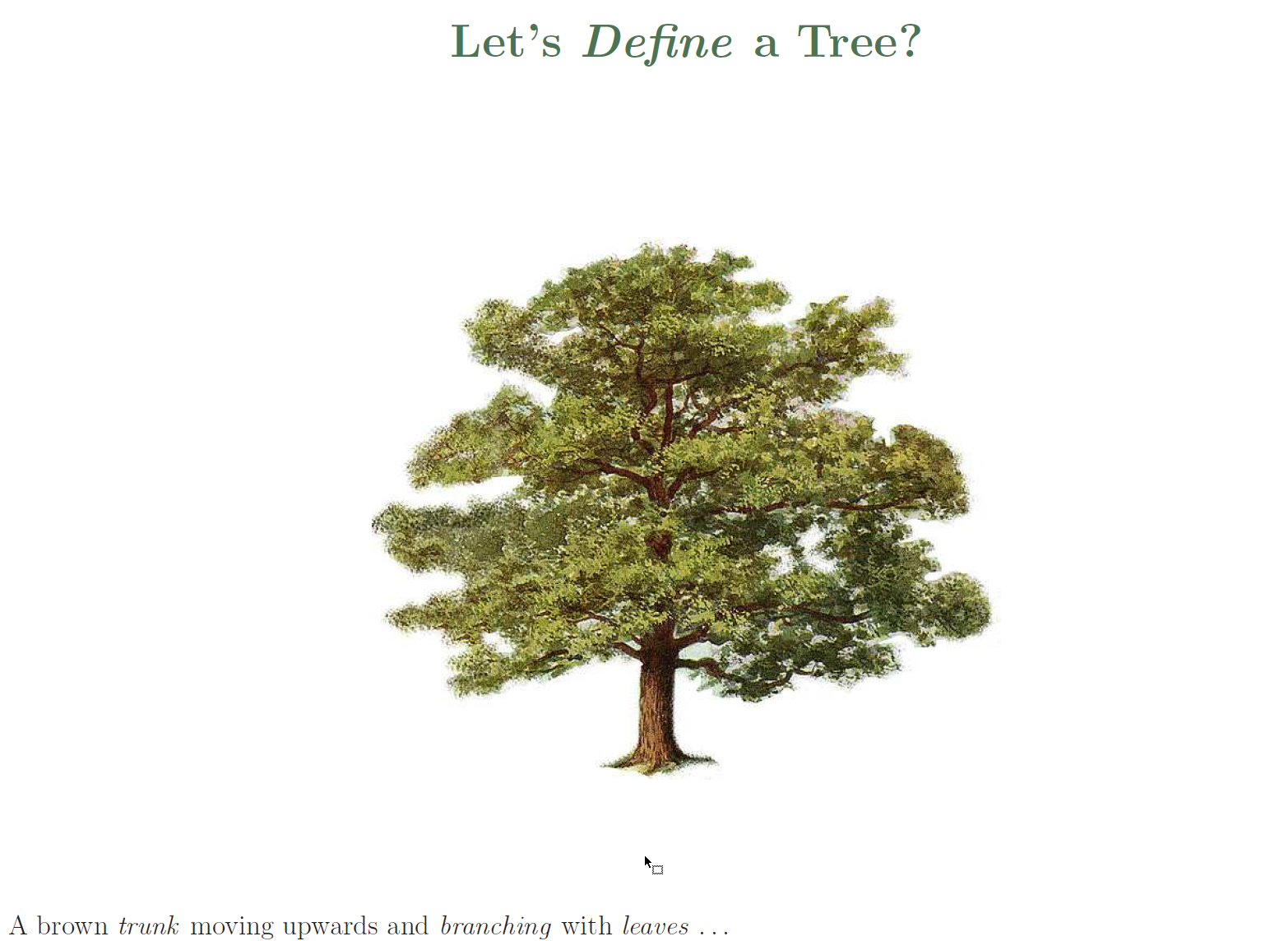

Slide 9
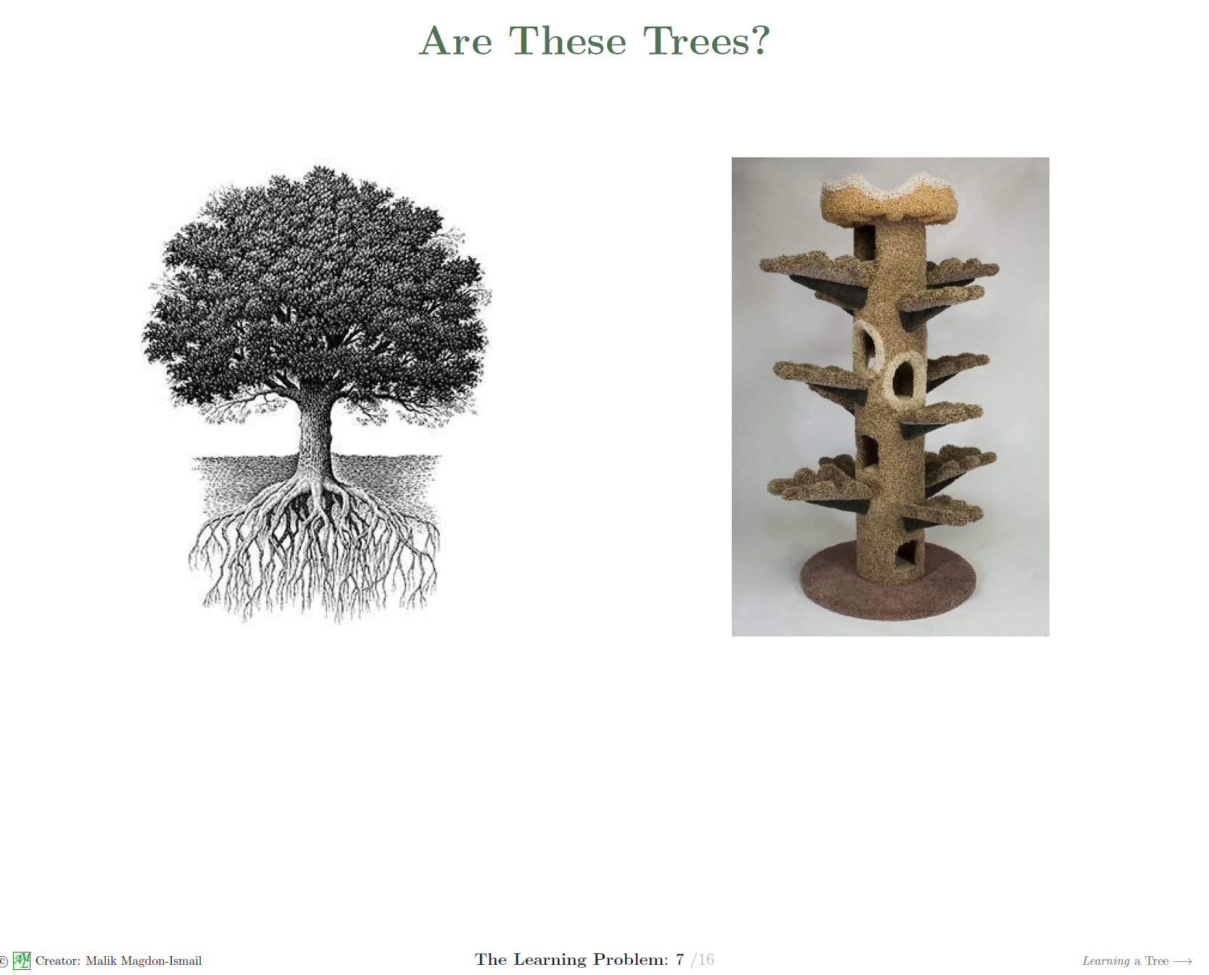

Slide 10
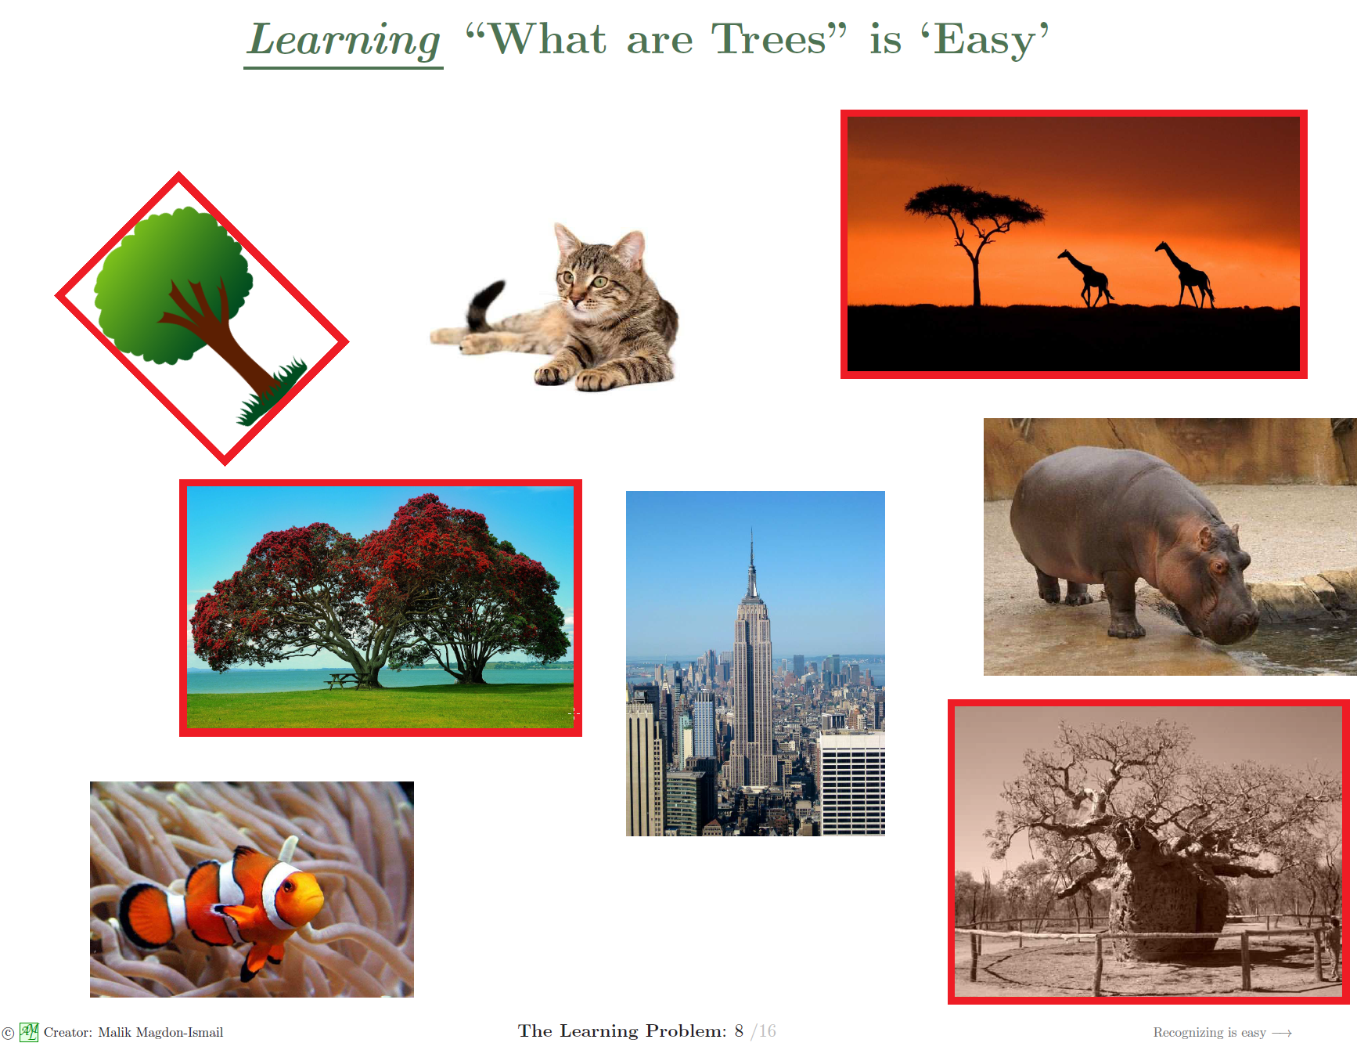

Slide 11
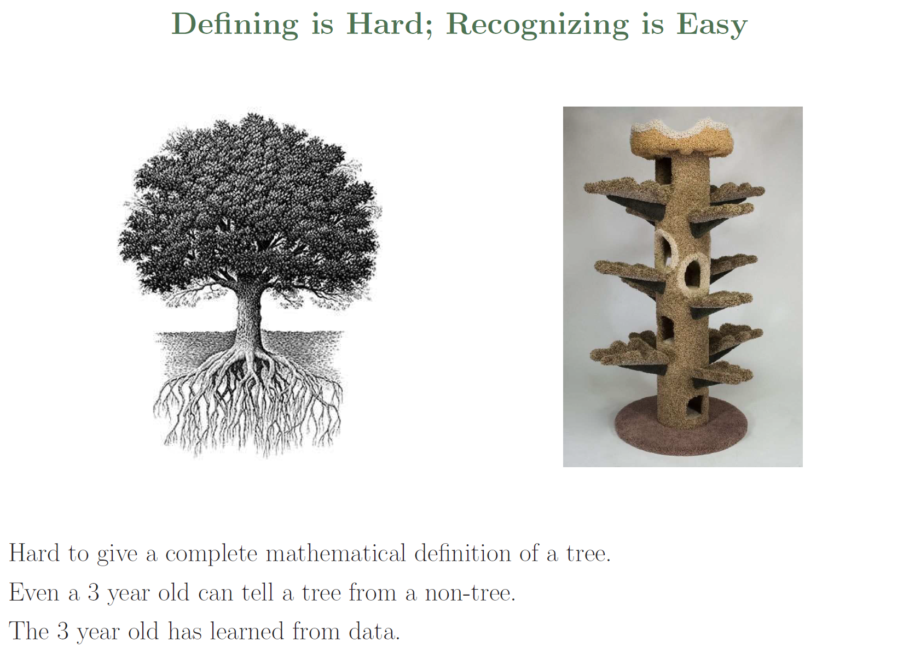

Slide 12
What Problems can be Solved by Machine Learning?
1. Machine learning needs data to train models.
Text data
Image data
Audio data
Other numerical data (length, age, rating, price, etc)
Categorical data (gender, positive/negative, shape, types etc)
2. We can apply machine learning only when data has pattern.
3. If the problem has explicit mathematics formulas, we do not need machine learning.

Slide 13
Types of machine learning
Machine learning is usually divided into three types:
Supervised learning
Unsupervised learning
Reinforcement learning.
Supervised learning is by far the most widely used.
Other by-product of machine learning:
Generative models (GenAI)
Autoencoder

Slide 14
Supervised Learning
Supervised Learning
The machine learning task of inferring a function from labeled training data.
A set of labeled data is used to train the system.
The trained system can be applied to test data to make prediction.
Examples:
Recognizing objects
Identifying spam emails
Predicting stock prices
Natural language recognition
Protein structure prediction
Children adult height prediction

Slide 15
Supervised Learning
Supervised Learning can be categorized into regression and classification
Regression: the dependent variable is a real value variable.
Stock price prediction
Children's adult height prediction
Weather temperature prediction
Sale forcast
Classification: the dependent variable is a categorical variable
Classify an email to SPAM or non-SPAM (2-classes).
Identify what objects are in a picture (multiple classes)
Disease diagnosis (2-classes)

Slide 16
Unsupervised Learning
Unsupervised Learning
the goal is to find “interesting patterns” in the data.
The data has no target attribute.
Data is not labeled.
No obvious error metric to use (unlike supervised learning).
Sometimes called knowledge discovery.
Examples:
Image clustering
Anomaly detection
Gene Sequence Analysis

Slide 17
Reinforcement Learning
Reinforcement learning: an agent learns to make decisions by interacting with an environment. It is inspired by the way humans and animals learn from trial and error to achieve certain objectives.
Examples:
Game playing
Robotics
Autonomous vehicles
Natural Language Procesing

Slide 18
Large Language Models
Large Language Models such as ChatGPT, Gemini, MS Copilot, Github Copilot, Llama, etc are trained by a combination of unsupervised, supervised, and reinforcement learning in difference phases.
In the Pretraining stage, unsupervised or self-supervised.
In the Fine-Tuning stage, it is supervised.
After that, the model can be training by reinforcement learning from Human Feedback (RLHF)

Slide 19
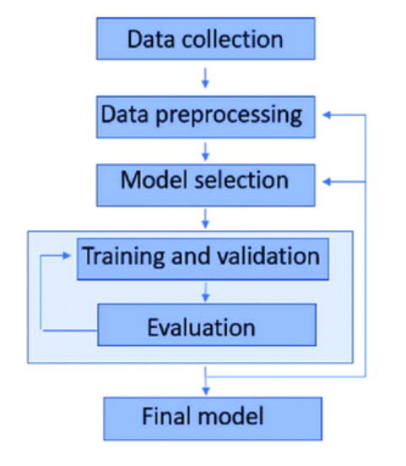
Machine Learning Workflow
Problem definition
Data Collection
Data Preprocessing
Model Selection
Model Training/Validation
Model Evaluation
Final Deployment
Monitoring and Maintenance

Slide 20
Jupyter Notebook
Jupyter Notebook is an open-source web application that allows you to create and share documents containing Python code and Markdown text.
It is considered the de facto standard for many machine learning (ML) development workflows, thanks to its flexibility, interactivity, and ease of use.
Jupyter Notebook Code can run:
on Jupyter Notebook Server as part of Anaconda
Remote servers
Free online service:
Google Colab colab.research.google.com
Kaggle Kernels: www.Kaggle.com/kernels
Microsoft Azure: notebooks.azure.com

Slide 21
Working with Notebook
A Notebook consists of multiple cells. A cell can be:
Python Code
Markdown Text
The Notebooks in Google Colab is slightly different to Jupyter Notebooks coming with Anaconda.

Slide 22
Working with Google Colab
Use any web browser such as Chrome, MS Edge, Apple Safari, etc to open https://colab.research.google.com
Click File->Open, you will be able to open a Jupyter Notebook file.
You can open a notebook through:
Google Drive (in your personal account's Colab Notebooks folder).
From Github
Upload notebook files.

